Slide 1
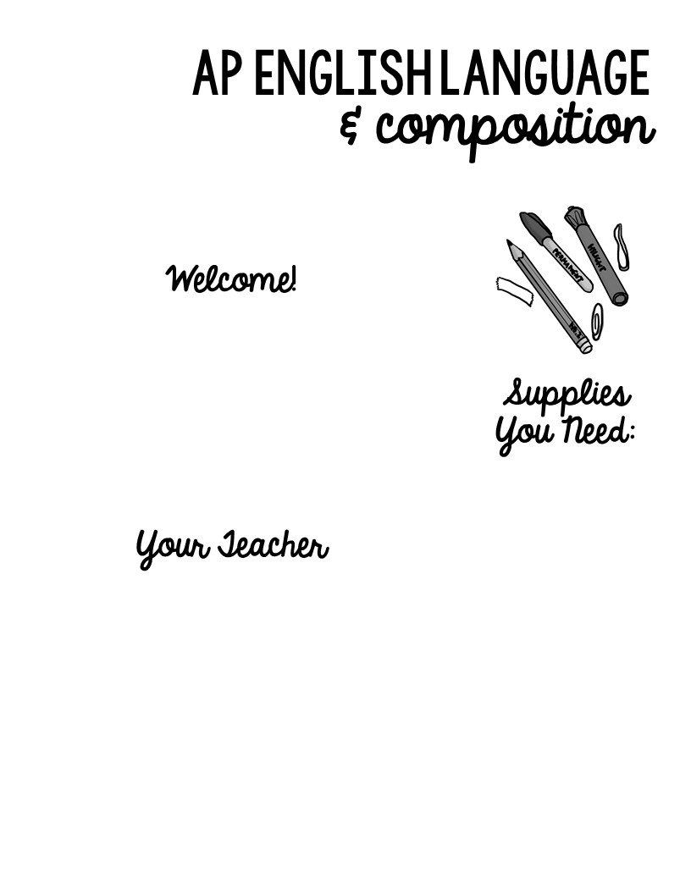
Syllabus
I’m excited for the year ahead, and I hope you are too. If you are feeling a little nervous about this class, that’s okay. Remember that even though this is a college-level course, I’m still a high school teacher and I’m here to ensure you learn everything you need to become a successful reader and writer in your life beyond high school.
3 inch binder with100+ sheets of loose-leaf paper
OR
a notebook with perforated edges
Highlighter (encouraged)
Blue or black Ink pens
My name is Mrs. Vushaj (pronounced Vu-shy, like a shy person). I graduated from SUNY Oswego in 2008 with my BA in Adolescence Ed, and then I graduated with my MS in Literacy from Mercy college in 2012. This is my 16th year at Barack Obama School for Social Justice, where I teach this class and English 11. Email is the fastest way to reach me:
lvushaj@yonkerspublicschools.org

Slide 2
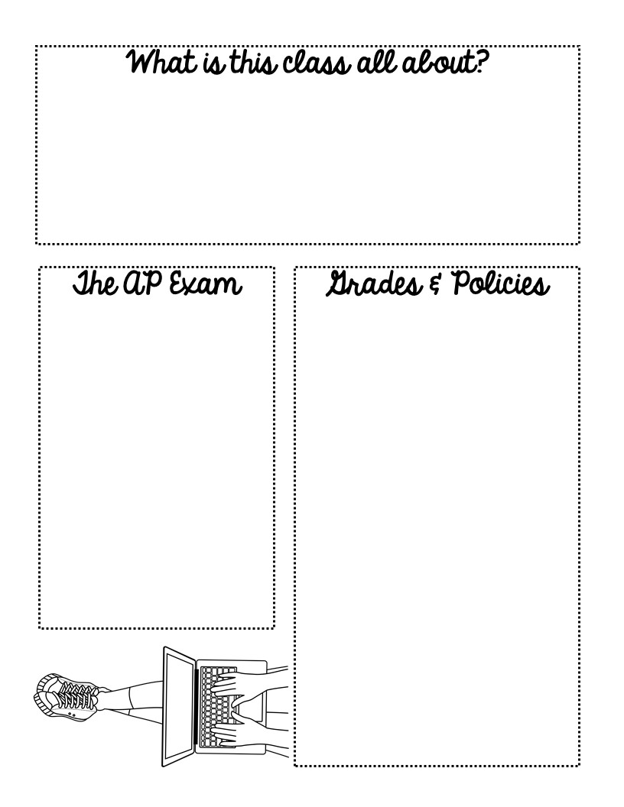
“The AP English Language and composition class focuses on the development and revision of evidence-based analytic and argumentative writing, the rhetorical analysis of nonfiction texts , and the decisions writers make as they compose and revise. In this class, students evaluate, synthesize, and cite research to support their arguments. Additionally, they read and analyze rhetorical elements and their effects in nonfiction texts—including images as forms of text—from a range of disciplines and historical periods.” (Updated Course and Exam Description, College Board, 2019).
NOT mandatory, but encouraged
Exam held:
Our exam is 44 multiple choice questions about reading and writing, then 2 hours and fifteen minutes to write 3 essays
The AP Credit Policy Search can help you determine which colleges will grant credit or advanced placement from your exam scores!
All assignments will be posted in Schoology and PowerSchool.
Daily Grades will come from small in-class and homework assignments.
Summative Grades will come from larger assignments (quizzes, essays, projects, presentations) that assess mastery of skills you’ve previously practiced. Essays will be deducted 10% from their grade each day they are late.
The English department defines PLAGIARISM as not giving appropriate attribution to ideas from other sources in one’s formally submitted work. Submitting a response that is AI generated is also considered plagiarism. Assignments containing plagiarism will receive a 0 grade and a referral for academic dishonesty.

Slide 3
Units of Study and the Four Big Ideas
.
Unit 1: Essential Concepts
Unit 2: American Voices
Unit 3: Foundations of Argument
Unit 4: Advanced Argument
Unit 4.5: The Art of Debate
Winter Break
Unit 5: Voice and Memoir
Unit 6: The Food Unit
Unit 7/8: Nonfiction Book Clubs
Unit 9: Final Exam Projects
These are the 4 course concepts that will guide our study this year:
Rhetorical Situation—Individuals write within a particular situation and make strategic writing choices based on that situation.
Claims and Evidence—Writers make claims about subjects, rely on evidence that supports the reasoning that justifies the claim, and often acknowledges or responds to other, possibly opposing, arguments.
Reasoning and Organization— Writers guide understanding of a text’s line of reasoning and claims this through that text’s organization and integration of evidence.
Style—the rhetorical situation informs the strategic stylistic choices that writers make

